Slide 1

SATHYABAMA INSTITUTE OF SCIENCE AND TECHNOLOGY (DEEMED TO BE UNIVERSITY) ………………………………………………………………….……………………………………………………………
PBLA
SECA1606 - EMBEDDED SYSTEMS
SMART AQUACULTURE
Date: 10-05-2024

Slide 2
Internal Guide
Dr. Jegan Antony Marcilin, M.Tech.,Ph.D.,
PROFESSOR/ECE
TEAM MEMBERS
Akhilesh Ch - 41130015
Allimilli Devi Naga Sai - 41130019
Anamdasu Uday Sai Kumar - 41130023

Slide 3
SCOPE
Designing and integrating hardware components including Arduino Uno R3, relay module, water level sensor, pH sensor, DS18B20 temperature sensor, and servo motor.
Developing software for data collection, processing, and control logic to optimize aquaculture conditions.
Conducting comprehensive testing, validation, documentation, and support to ensure functionality, reliability, and user satisfaction.

Slide 4
OBJECTIVE
Our aquatic wildlife are important sources of food, energy, jobs, atmospheric oxygen, buffers against new diseases, pests, and predators, and protection against food shortages and global climate change.
We found some solutions to provide a comfortable and suitable environment for the better survival of aquatic life. That is by using IoT by considering some parameters like pH, temperature, water level etc...
The servo motor integration in the project is to automate feeding processes, ensuring precise and timely distribution of food to aquatic organisms, thereby optimizing their growth and health while reducing manual intervention and operational workload for aquaculture practitioners.

Slide 5
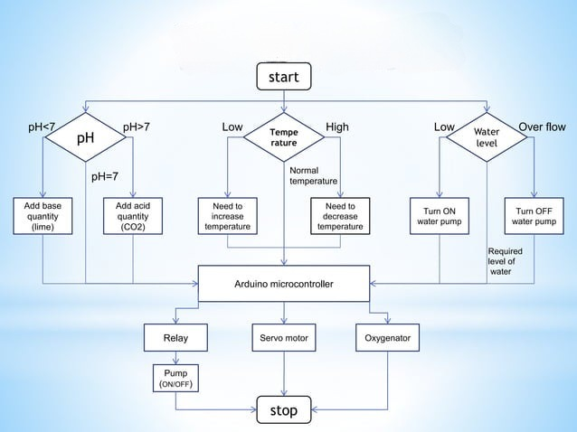
Flow chart

Slide 6
BLOCK DIAGRAM
Arduino uno
Ph Sensor
Water level sensor
Water level values
Water pump
Ph Values
Temperature sensor
Relay module
Temperature values
Servo Motor
Oxygenometer

Slide 7
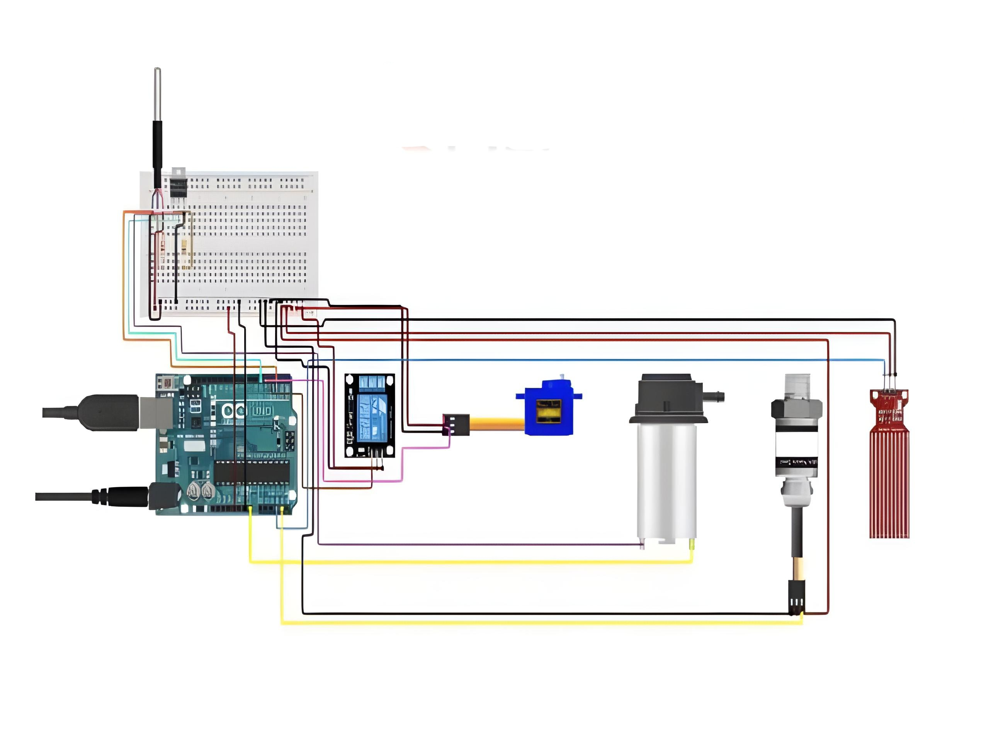
CIRCUIT DIAGRAM

Slide 8
METHODOLOGY
Integrating hardware components such as Arduino Uno R3, relay module, water level sensor, pH sensor, DS18B20 temperature sensor, and servo motor.
Developing software for real-time data processing and control algorithm implementation.
Conducting testing and validation procedures to ensure the effectiveness of the system in maintaining optimal environmental conditions for aquatic life.
Deploying the system in aquaculture settings and providing ongoing support and maintenance.

Slide 9
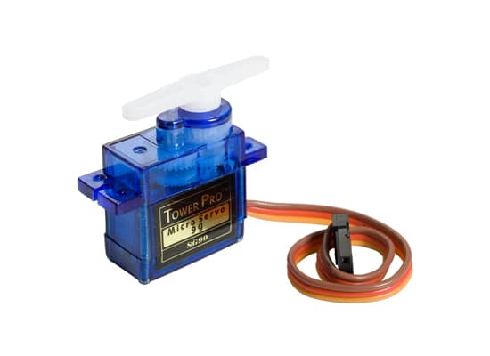
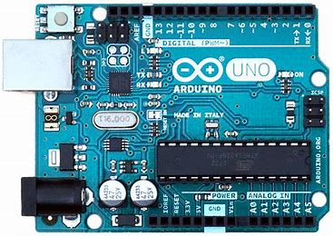
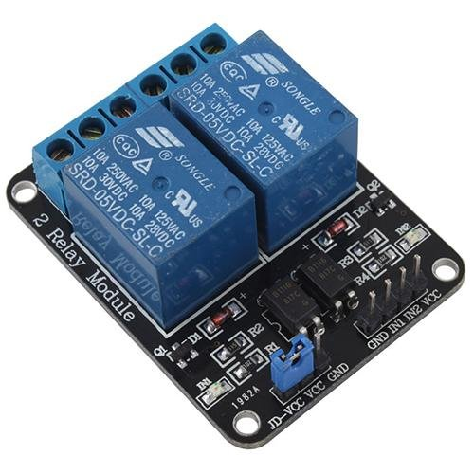
Proposed Components
Fig:Arduino UNO
Fig:Relay
Fig:Servo Motor

Slide 10
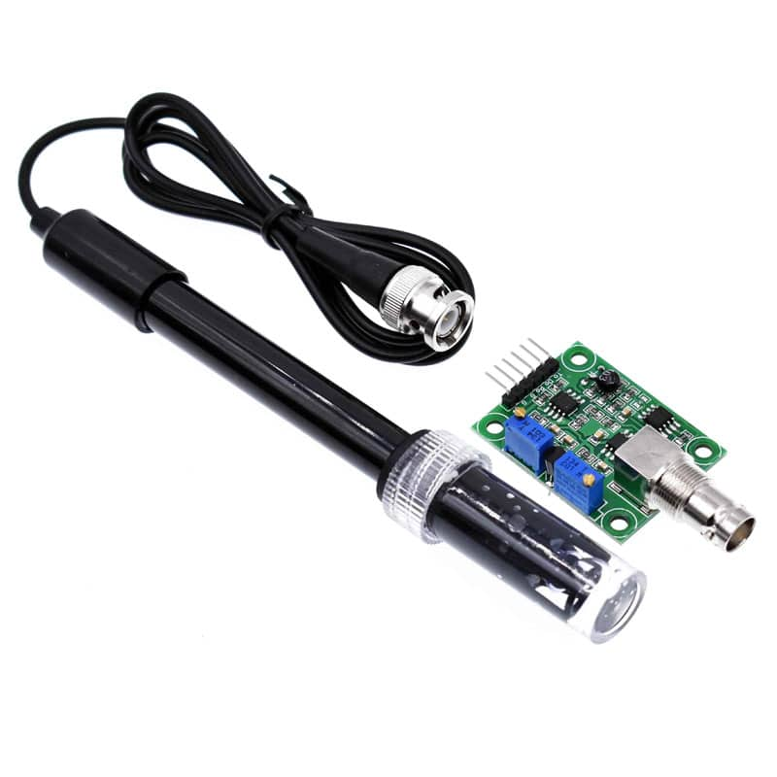
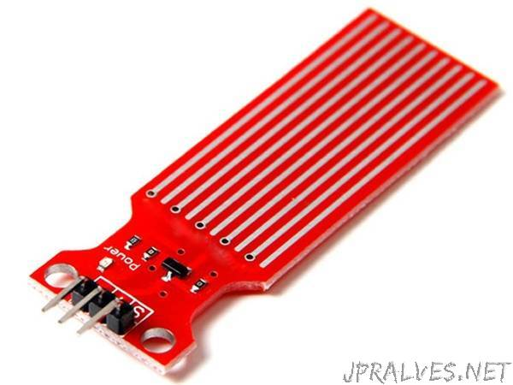
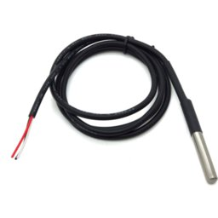
Proposed Components
Fig:Water Level Sensor
Fig:Ph Sensor
Fig:Temperature sensor

Slide 11
Specifications of all the purchased components
Arduino Uno:
The Arduino UNO is ATmega328 based Microcontroller board. It is one of the most popular prototyping boards. The board comes with built-in arduino boot loader.
While programming the board, it can be connected to the PC using USB port and the board can runs on USB power. The Arduino UNO has 32 Kb Flash memory, 1 Kb EEPROM and 2 Kb SRAM.

Slide 12
Specifications of all the purchased components
Relay:
Relays in Arduino Uno enable safe control of high-voltage devices through low-voltage signals. They serve as electromechanical switches, bridging the gap between the microcontroller's digital outputs and external loads like motors or lights. Relay modules, often equipped with additional components, provide galvanic isolation and protection.
Integration is straightforward, with relay control pins connected to Arduino digital pins. This simple setup empowers Arduino enthusiasts to create diverse projects, from home automation systems to industrial interfaces, blending digital precision with electromechanical reliability.

Slide 13
Specifications of all the purchased components
Servo Motor:
Servo motors in Arduino Uno projects offer precise control over angular position, ideal for robotics and automation. Connected directly to the Uno's PWM pins, servos receive signals to rotate to specific angles within their range.
Servo motors are great devices that can turn to a specified position.Usually, they have a servo arm that can turn 180 degree.Using the Arduino,we can tell a servo to go to a specified position and it will go there.

Slide 14
Specifications of all the purchased components
Water Level Sensor:
Water level sensors in Arduino Uno projects detect water presence or absence, crucial for monitoring tanks, reservoirs, or automated irrigation systems. These sensors operate on conductivity or ultrasonic principles, detecting water based on its conductivity or by emitting ultrasonic waves and measuring reflections.
When water is present, the sensor sends a signal to the Arduino Uno, triggering programmed actions like activating pumps or sending notifications. Arduino Uno's analog or digital pins receive input signals from the sensor, allowing for real-time monitoring and control. The integration of water level sensors enhances the efficiency and automation of various water management systems, promoting resource conservation and reducing manual intervention.

Slide 15
Specifications of all the purchased components
Ph Sensor:
The pH Sensor looks like a rod usually made of a glass material having a tip called "Glass membrane". This membrane is filled with a buffer solution of known pH. We used this in our project for regular supervision of the pH level of the water, which plays a vital role in the growth of aquatic life.
pH sensors in Arduino Uno projects measure the acidity or alkalinity of a solution, vital for applications like hydroponics, aquaponics, or water quality monitoring. These sensors typically utilize a glass electrode that generates a voltage proportional to the hydrogen ion concentration in the solution.

Slide 16
Specifications of all the purchased components
Temperature Sensor(DS18B20):
The DS18B20 is a 1-wire programmable Temperature sensor from maxim integrated. It is widely used to measure temperature in hard environments like in chemical solutions, mines or soil etc. The constriction of the sensor is rugged and also can be purchased with a waterproof option making the mounting process easy.
It can measure a wide range of temperature from -55°C to +125° with a decent accuracy of ±5°C. Each sensor has a unique address and requires only one pin of the MCU to transfer data so it a very good choice for measuring temperature at multiple points without compromising much of your digital pins on the microcontroller.

Slide 17
WORKING
Our project works on the basis of Internet of Things using Arduino. All the components are connected to Arduino in which code is built with required threshold values to the respective components. pH sensor is used to check the pH of the water, whenever it is low, base quantity is added and when high, acid quantity is added with the help of servomotor, which is also used to provide food to the aquatic species by fixing time intervals as per our requirement. Temperature sensor is used to check the temperature of the water, whenever high or low it adds water with the help of pump connected to relay. Water level sensor is used to monitor the level of water, whenever water level is low, pump is turned ON, when it is high, pump is turned OFF. Oxygenator is used to provide oxygen to aquatic species.

Slide 18
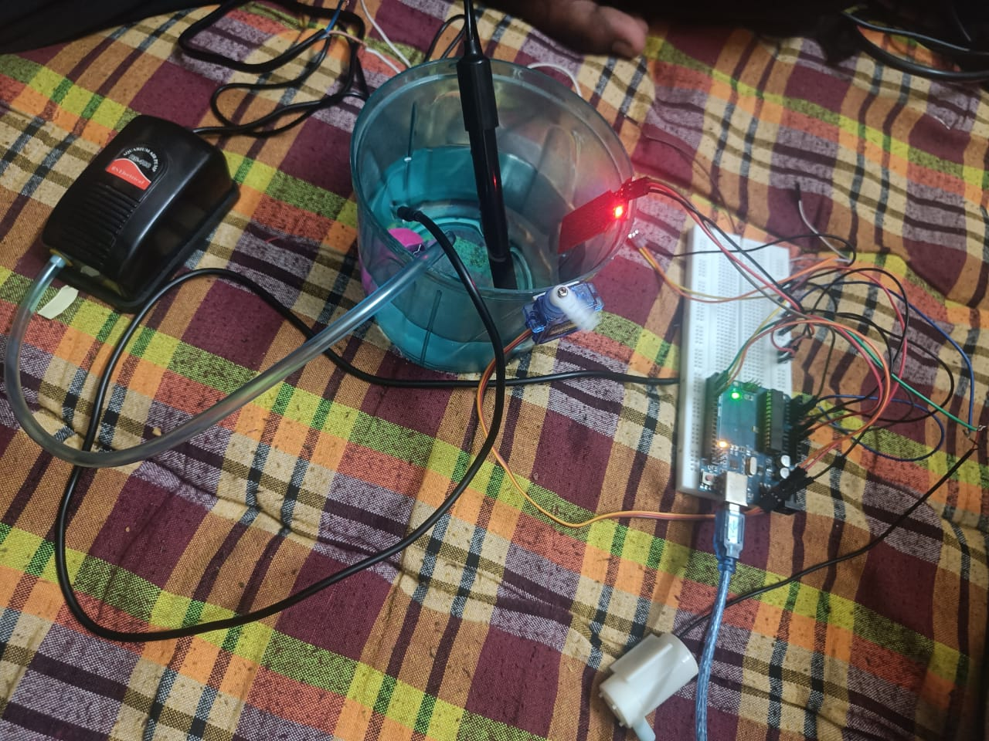
PROTOTYPE

Slide 19
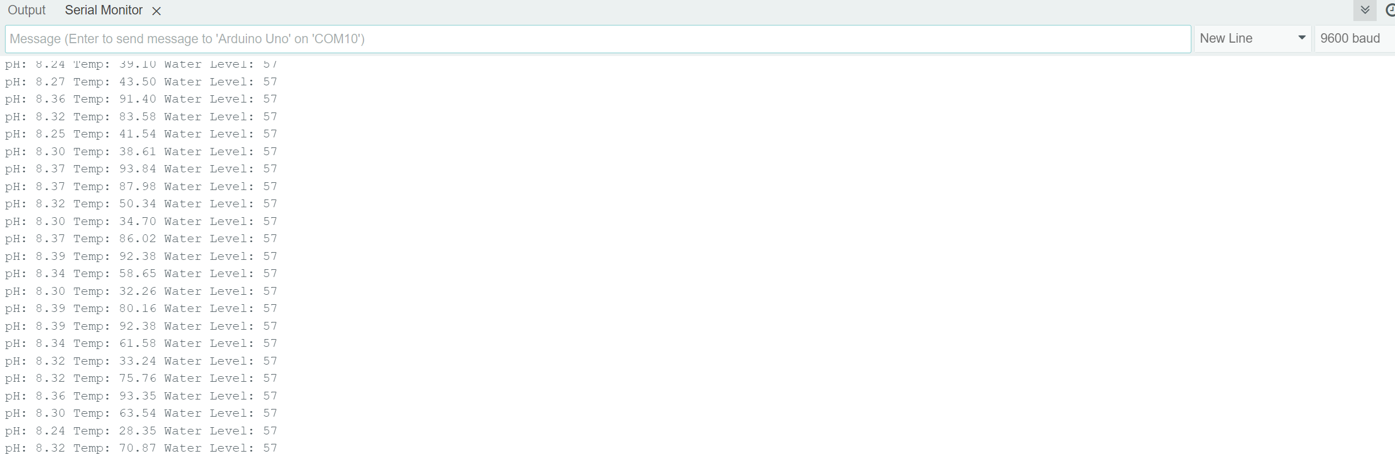
OUTPUT

Slide 20
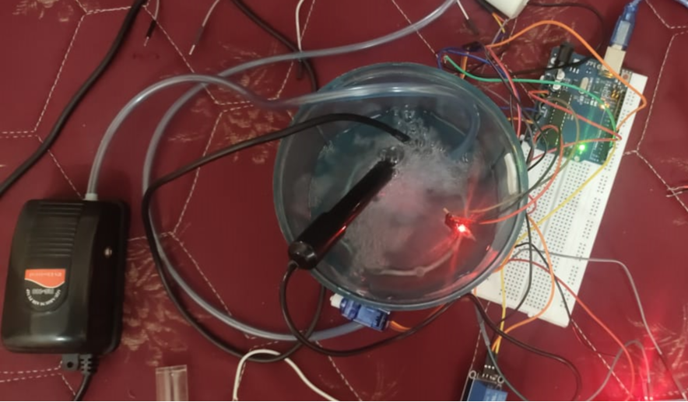
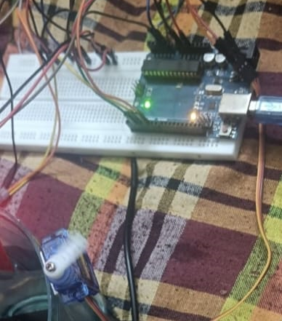
OUTPUT

Slide 21
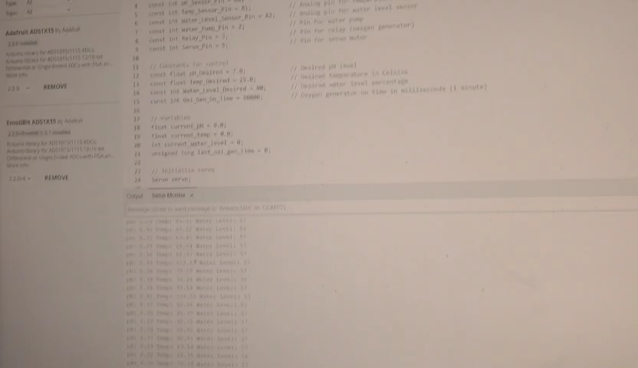
OUTPUT

Slide 22
Justification for Deviation
The chosen methodology deviates slightly from the initial proposal to better align with the specific requirements and constraints of the smart aquaculture project. By integrating additional sensors and components such as the water level sensor and servo motor, the system can cater to the unique needs of aquaculture environments, ensuring optimal conditions for aquatic life. This deviation allows for enhanced automation and control within the aquaculture system, enabling processes such as feeding automation and water level monitoring to be more effectively managed. Furthermore, by refining the software algorithms and incorporating stakeholder feedback, the system operates more efficiently and reliably, minimizing errors and ensuring consistent performance. Ultimately, this deviation from the initial methodology is driven by the project's focus on customization, efficiency, and stakeholder satisfaction, leading to a more comprehensive and robust smart aquaculture solution.

Slide 23
REFERENCES
[a]. Garcia, M., S. Sendra, G. Lloret, and J. Lloret. (2011). “Monitoring and control sensor system for fish feeding in marine fish farms”. IET Communications, (5), PP. 1682-1690,.
[b]. Sung, W.T., J.H. Chen, and H.C. Wang. (2014). Remote fish aquaculture monitoring system based on wireless transmission technology. In Proceedings of the IEEE international conference on information science, electronics and electrical engineering ISEEE, PP. 540- 544.
[c]. Dzulqornain, M. I., M. U. H. Al Rasyid, and S. Sukaridhoto. (2018). Design and development of smart aquaculture system based on IFTTT model and cloud integration, in Proceedings of the MATEC Web of Conferences. EDP Sciences PP. Page 01030.
[d]. Raju, K. R. S. R., and G. H. K. Varma, (2017). Knowledge based real time monitoring system for aquaculture using IoT, inProceedings of the IEEE 7th International Advance Computing Conference (IACC). IEEE, PP. 318-321.
[e]. Sj, A., and E. Ng. (2015). Aquaculture Sentinels: Smart-farming with Biosensor Equipped Stock. Journal of Aquaculture Research & Development 07.

Slide 24
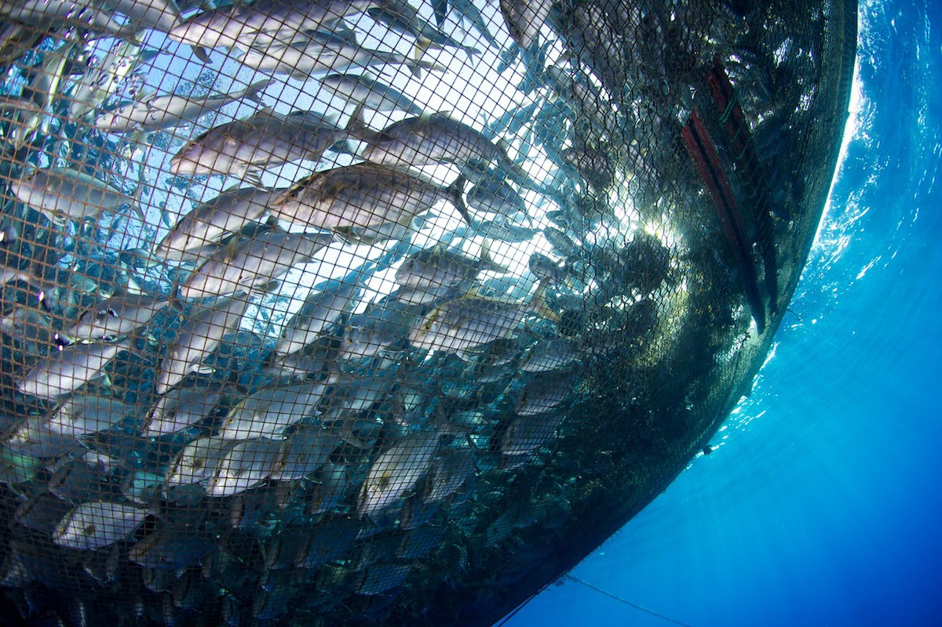
THANK YOU.!

